Slide 1
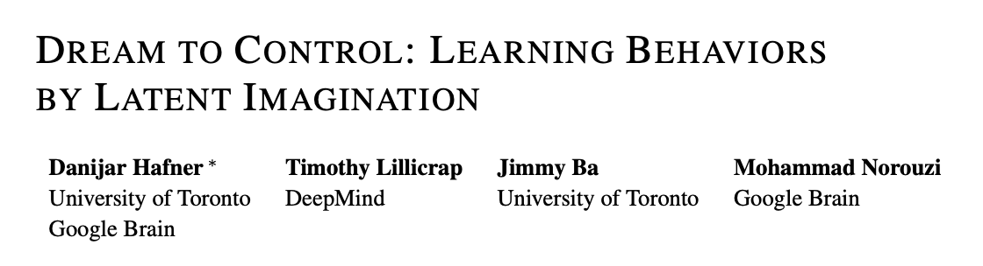
汇报人：刘翎，邓雅萱，沈思甜，王天泽，孙瑞祥

Slide 2
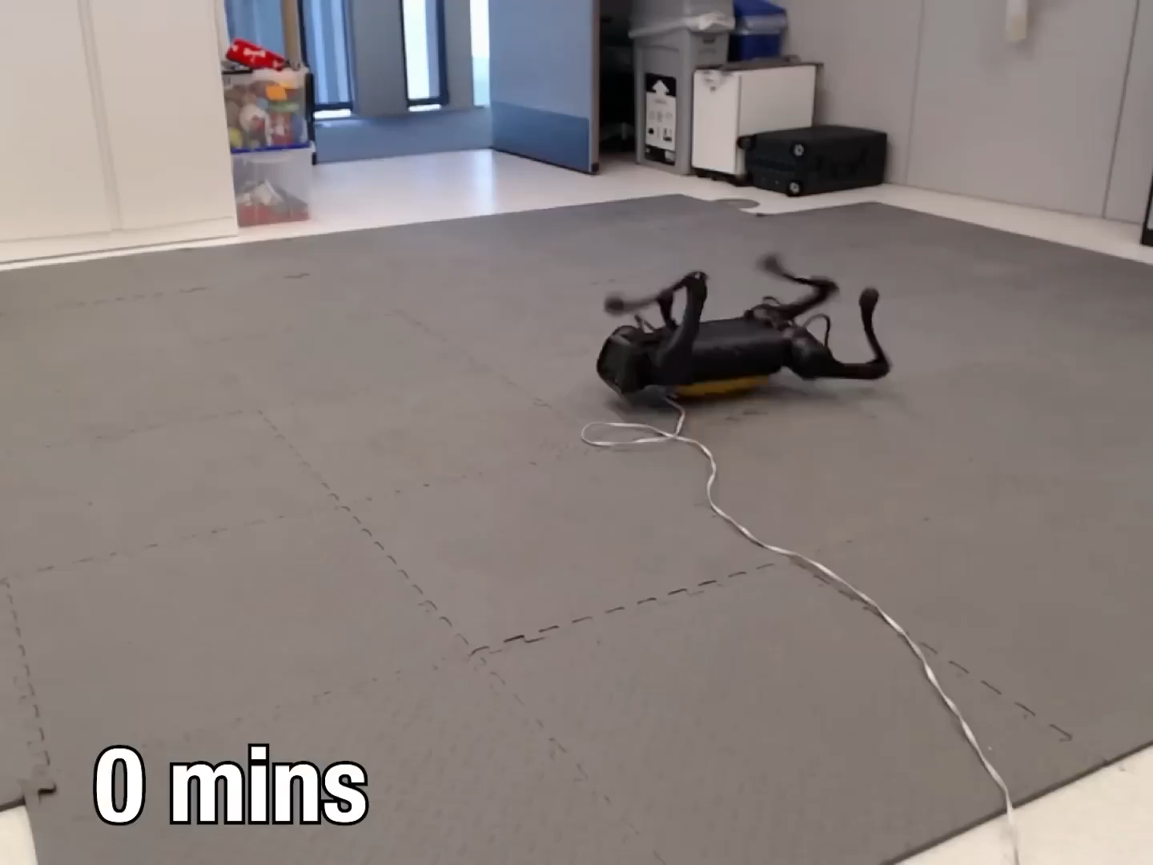
Learning to Walk in the Real World in 1 Hour
0

Slide 3
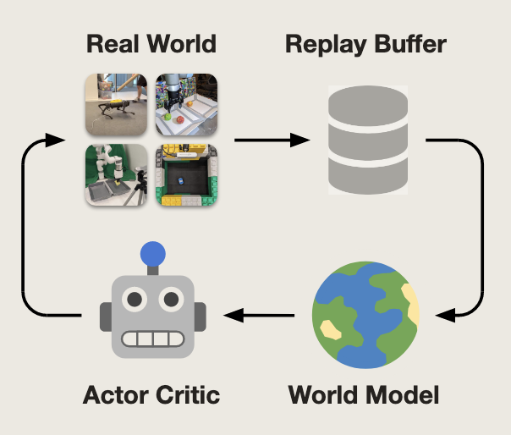
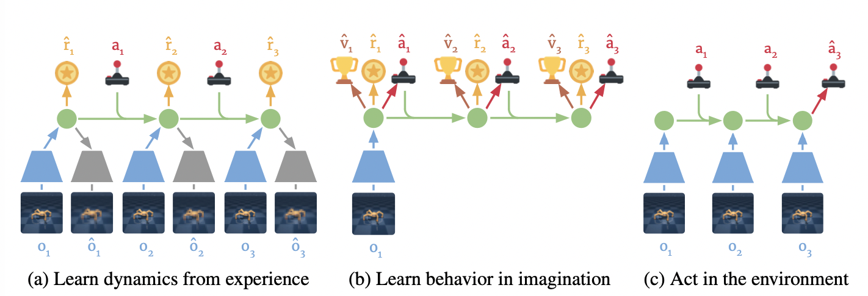
Overview - Model
1

Slide 4
The World Model
2
RL Approaches
Model-Based
Model-Free

Slide 5
The World Model
2
Model-Based Approaches
Model-Free Approaches
Leaning in the Real World
Requires a large amount of trial and error, limiting their usefulness in real-world scenarios.
Learning in a Simulator
The simulator often fails to reflect the complexity of the real world, making it hard to adapt to changes in the real world.
Not directly applicable to real-world scenarios.

Slide 6
The World Model
2
Learned World Model
+
Model-Based Approaches
D. Ha and J. Schmidhuber. World models. arXiv preprint arXiv:1803.10122, 2018.

Slide 7
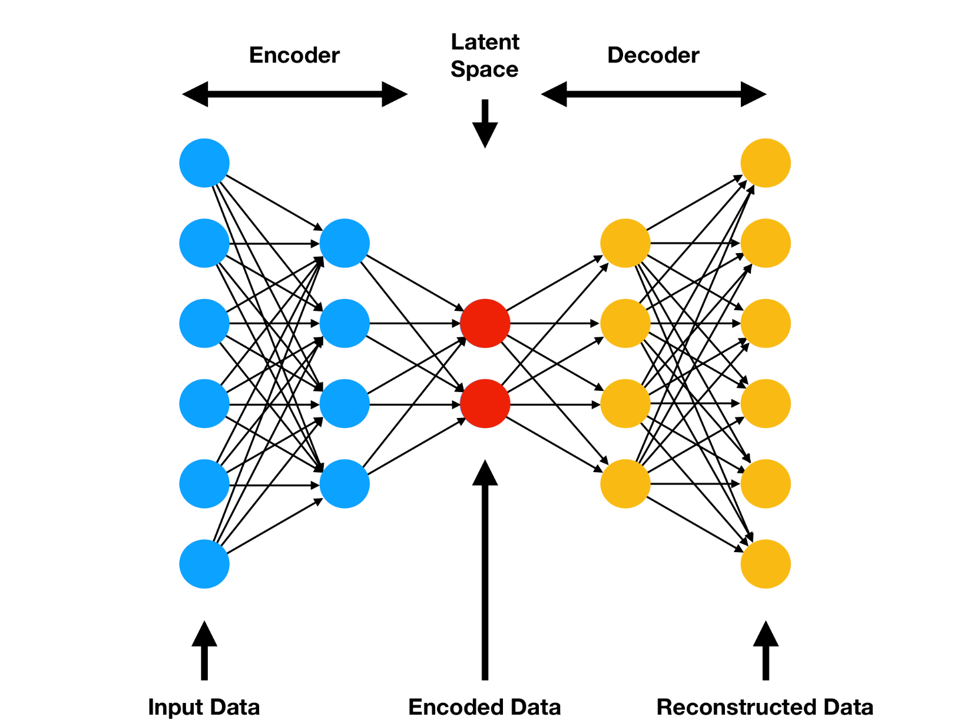
The World Model
2
Autoencoders

Slide 8
The World Model
2
Latent Dynamics Model
Representation Model
Observation Model
Transition Model
Reward Model

Slide 9
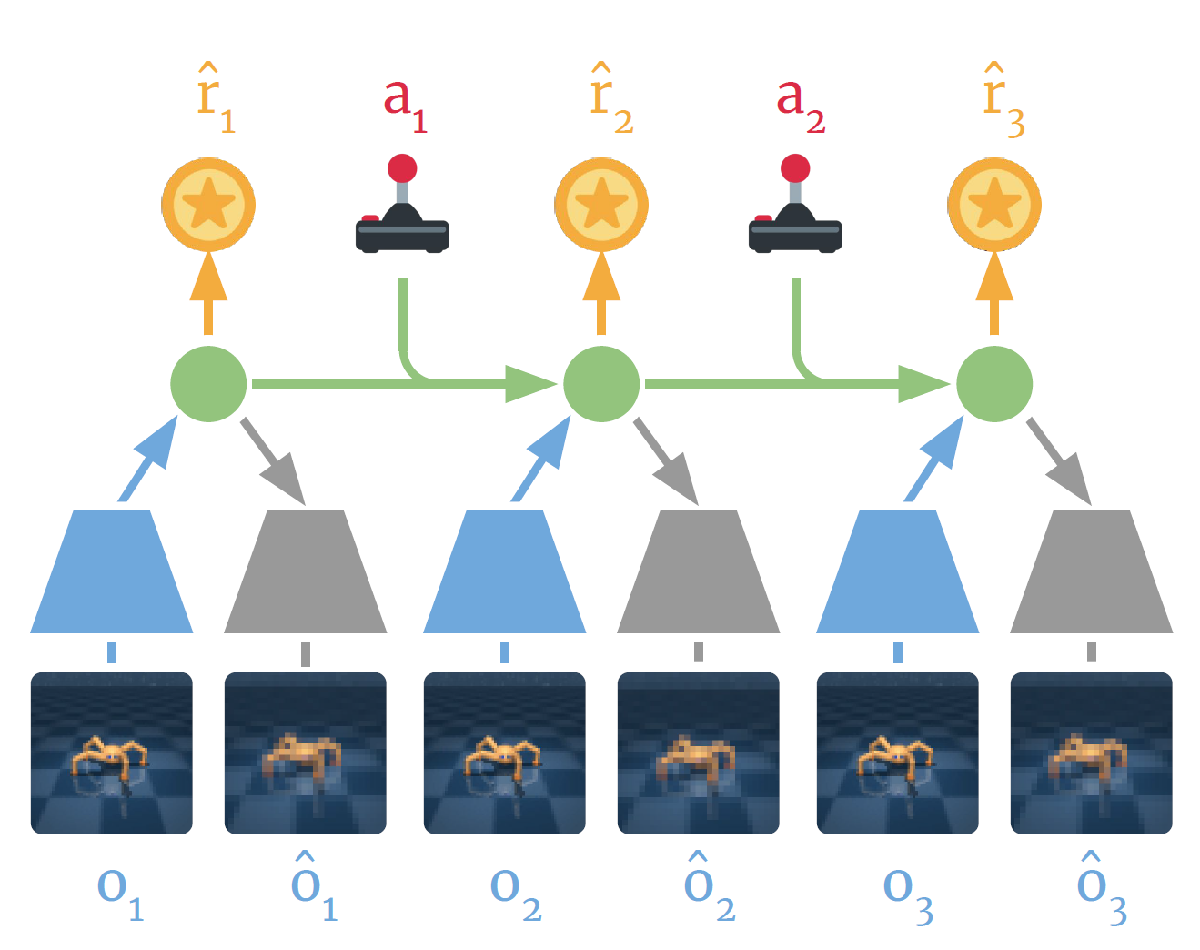
The World Model
2
Rewards
Actions
Latent States
Observations

Slide 10
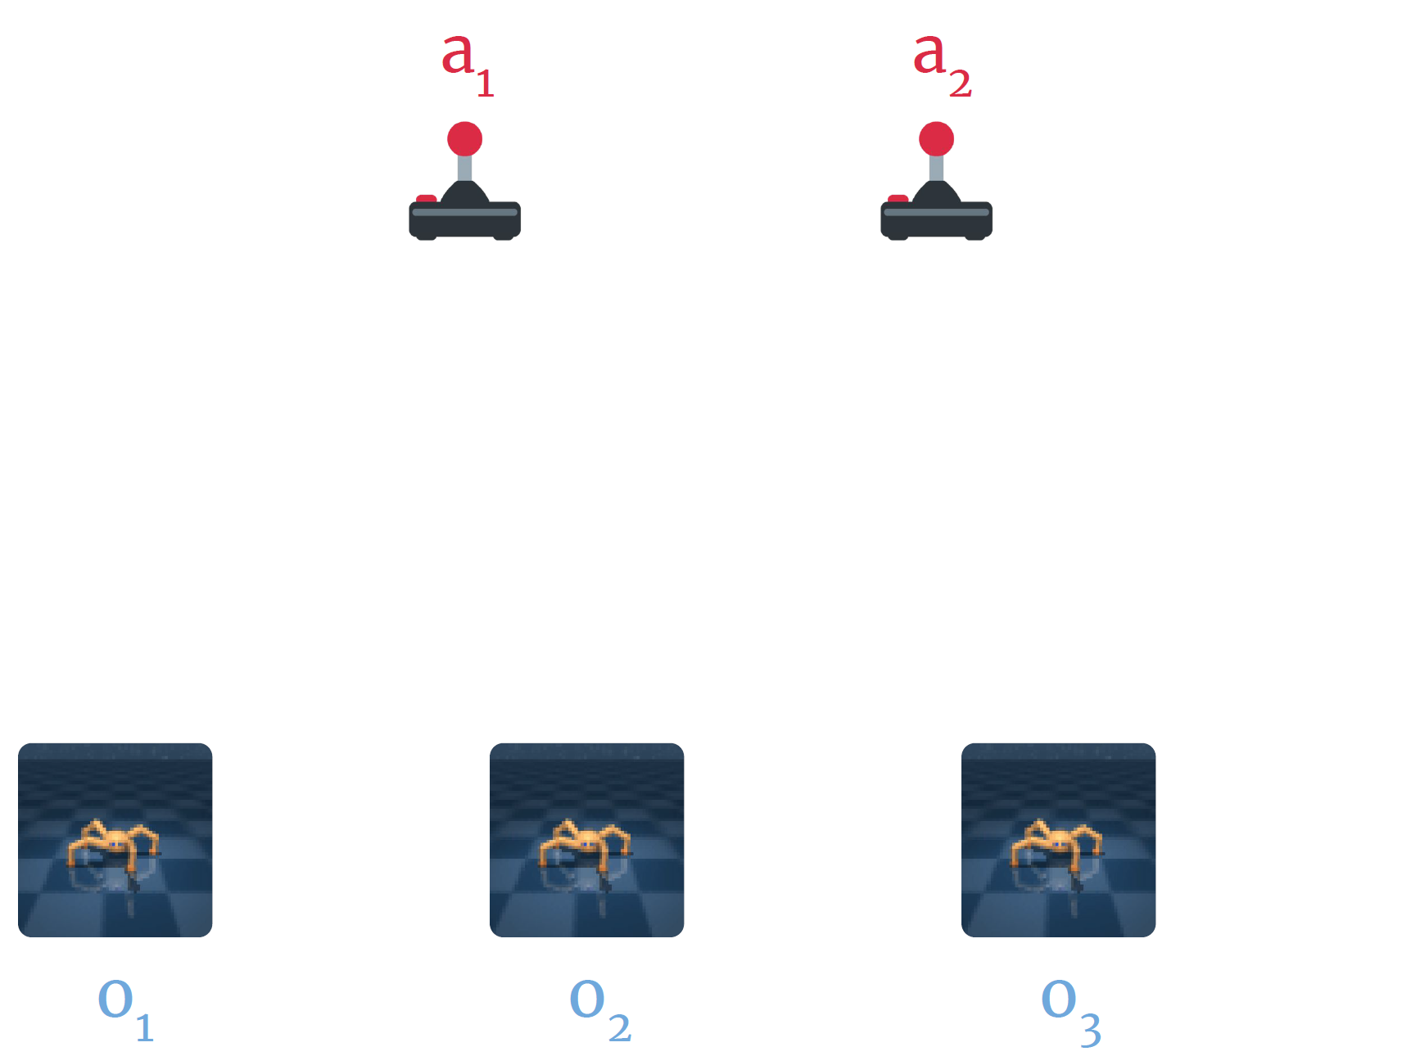
The World Model
2

Slide 11
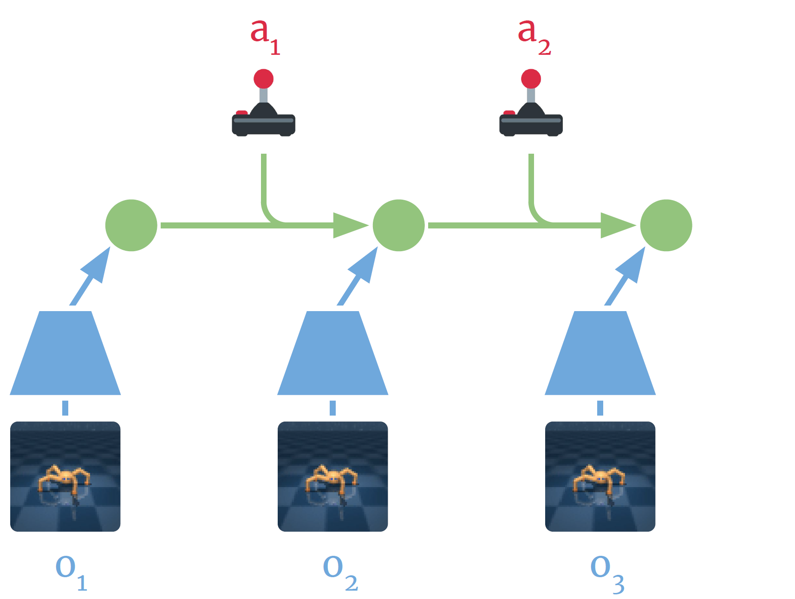

The World Model
2
Encode Images

Slide 12
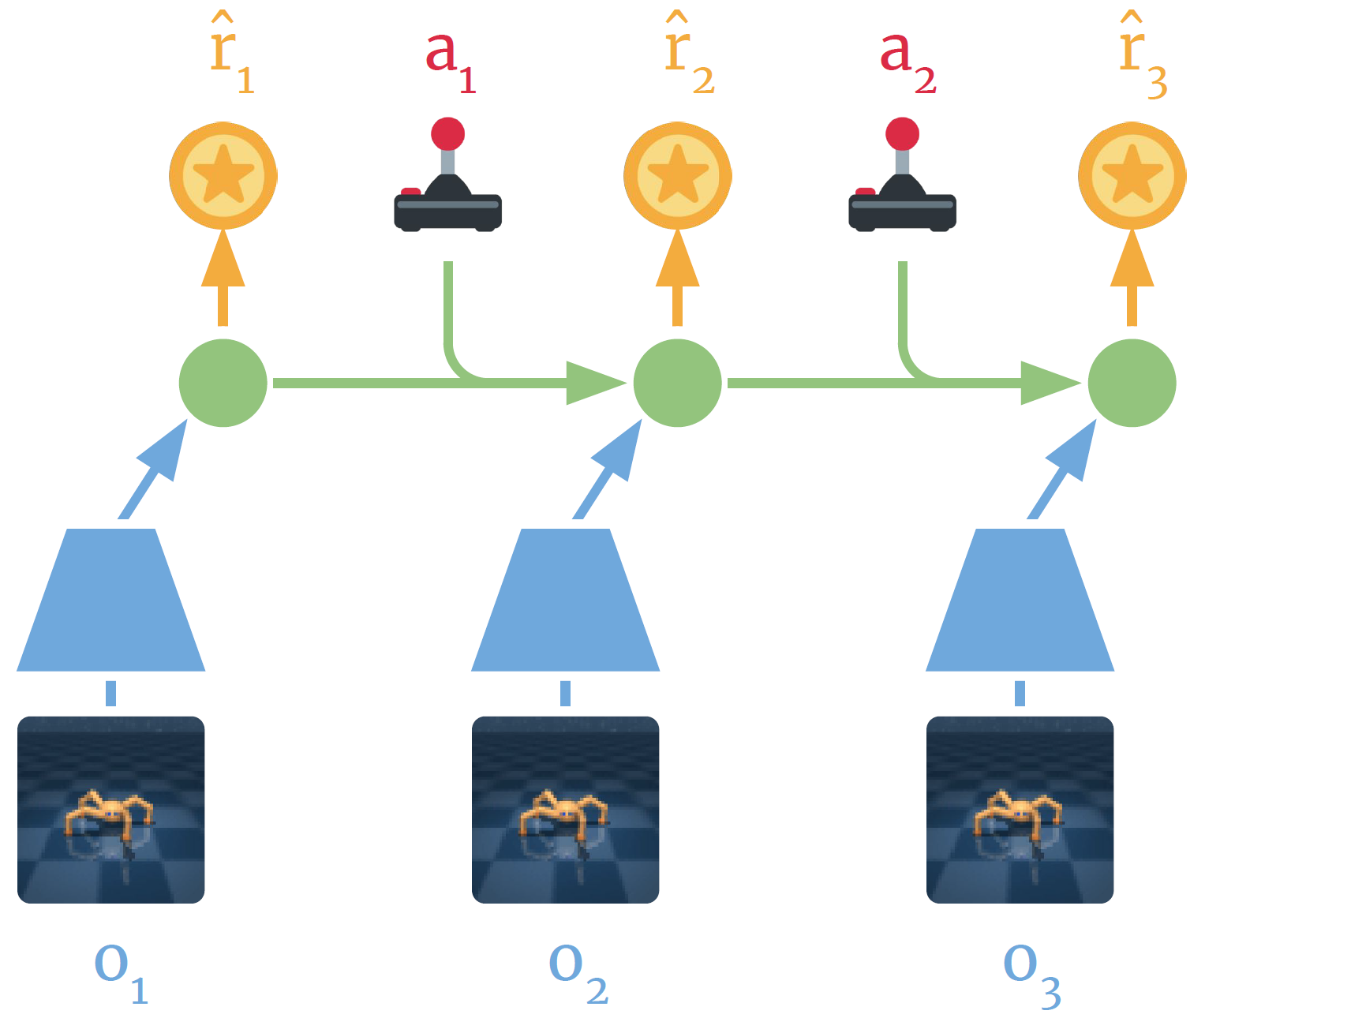

The World Model
2
Encode Images
Predict Rewards

Slide 13
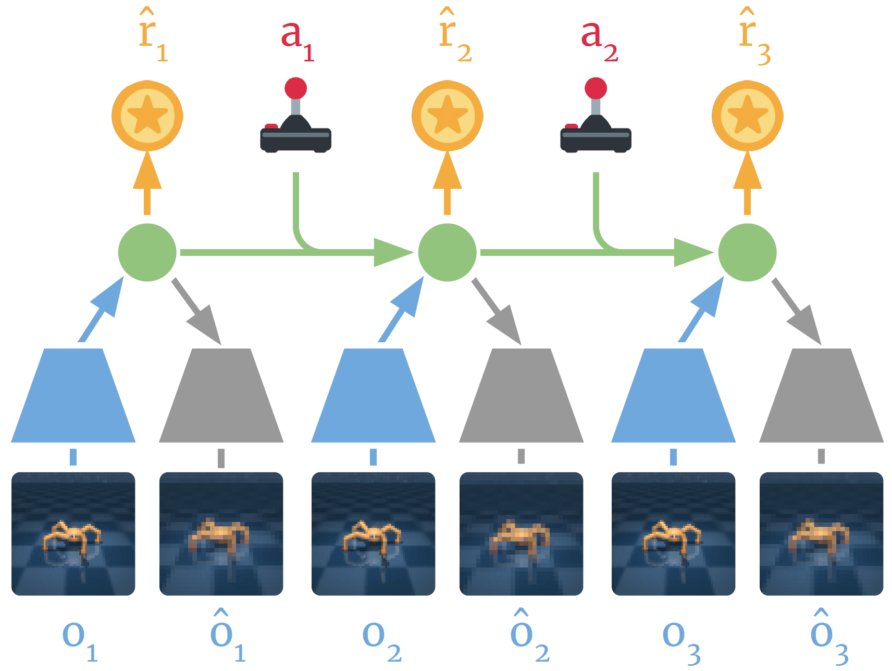

The World Model
2
Encode Images
Predict Rewards
Reconstruction

Slide 14
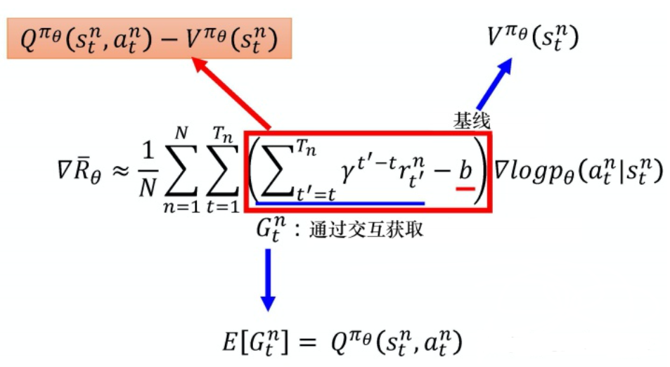
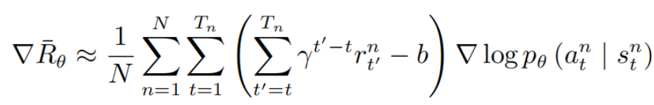
Behavior Learning
3
Policy Gradient
Actor Critic
Notes:
在讲Behavior Learning之前，我们先回顾一下Actor-critic算法。演员是指策略函数πθ(a|s)，即学习一个策略来得到尽量高的回报。
评论员是指价值函数 V π(s)，对当前策略的Value function进行估计，来评估演员的好坏。（value-based + policy-based相结合）
在这篇文章中，我们使用类似的方法，最大的区别就在于，我们对Value function的估计方式，
是通过与World Model这一想象出的模型交互得到的。

Slide 15
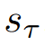
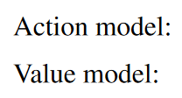
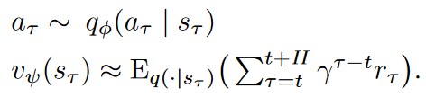
Behavior Learning
3
World Model
Action model
Value model
The action model implements the policy and aims to predict actions that solve the imagination environment.
The value model estimates the expected imagined rewards that the action model achieves from each state
Notes:
在已经想象出一个World Model之后，我们固定World Model不动，在这个想象出来的环境中，训练Action Model 和Value Model。其中Action Model是在每一个State下训练出采取行动的Policy，优化目标是最大化Value的估计值。那么这个Value如何去估计呢？

Slide 16
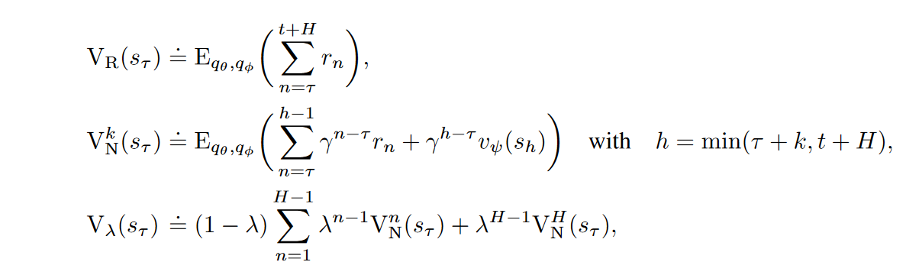
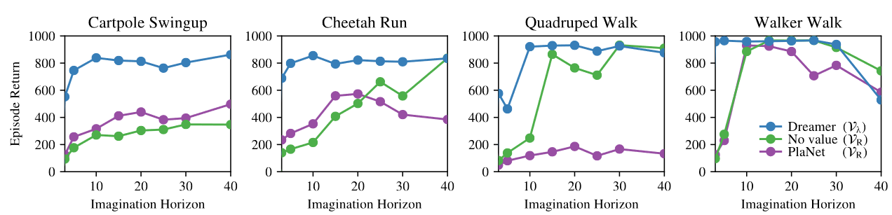
Behavior Learning
3
Value Estimation（Long Time Estimation）
Notes:
文章中，作者使用了这样三个方法对Value值进行估计。H表示dreamer对world model想象的边界，VR简单地将从τ到边界的Reward求和，而忽略了value。这使得我们可以在没有价值模型的情况下学习动作模型，文章中用这个value的估计方法进行对比实验。VNk利用学习到的价值模型估计往后k步的Value。h保证了往后的k步不超过dreamer的想象力边界。Dreamer使用V λ，对不同k的估计值进行指数加权平均，以平衡偏差和方差。实验结果表明，这样的价值模型估计可以使空想家在解决长视域任务的同时对想象力视域具有鲁棒性。

Slide 17
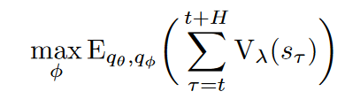
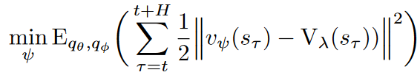
Behavior Learning
3
Learning Objective
Action
Value
Maxinize total value estimations
Regress the value estimates
Notes:
具体来看优化目标，我们的目标非常明确，对于Actor，我们希望行为策略对应的pi使得估计出来的总Value尽可能大。对于Critic，我们希望评价得到的value尽可能接近上述公式估计出来的Value。

Slide 18
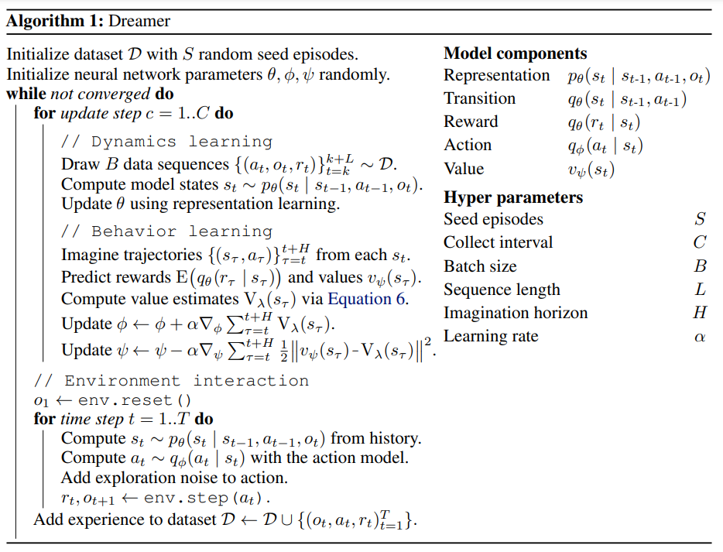
Pseudo code
4

Slide 19

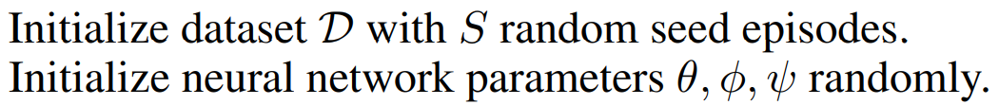
Initialize
4
Pseudo code

Slide 20
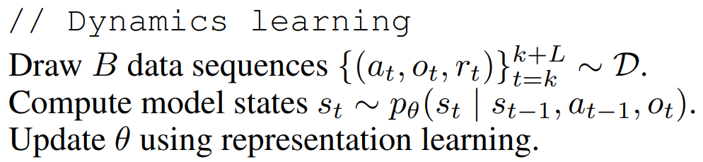
Initialize
4
Pseudo code

Slide 21
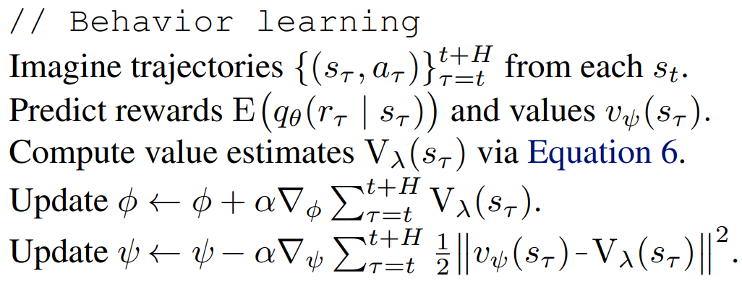
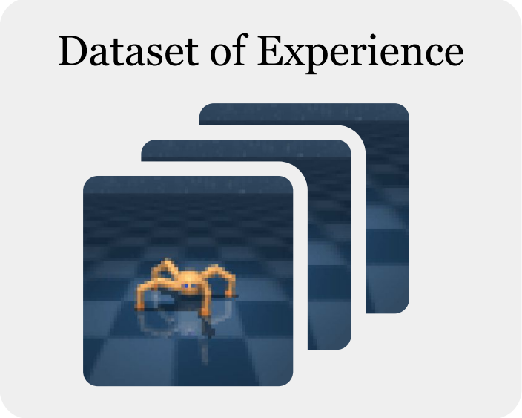
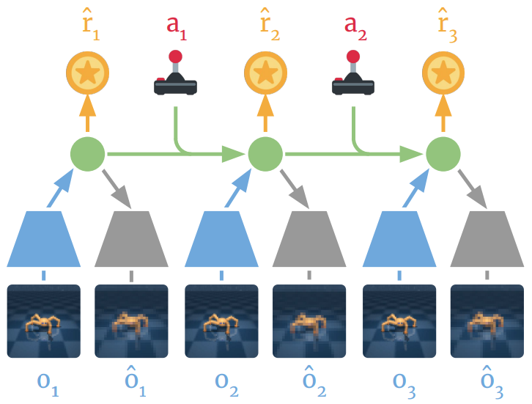
Dynamics learning
4
Pseudo code

Slide 22
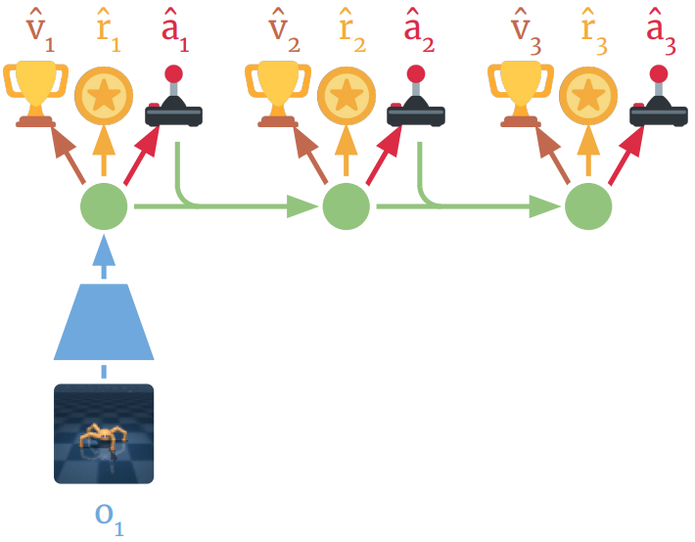
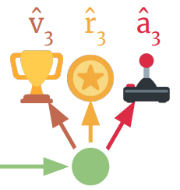
Behavior learning
4
Pseudo code

Slide 23
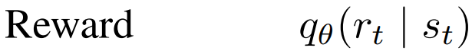
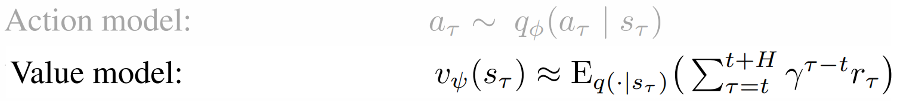
Behavior learning
4
Pseudo code

Slide 24
Behavior learning
4
Pseudo code

Slide 25
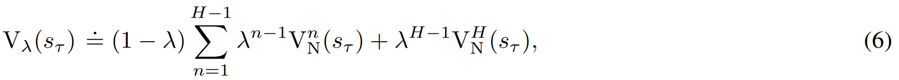
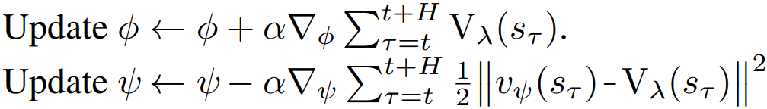
Behavior learning
4
Pseudo code

Slide 26
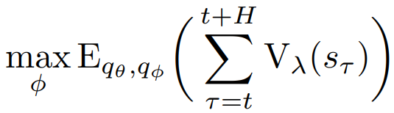
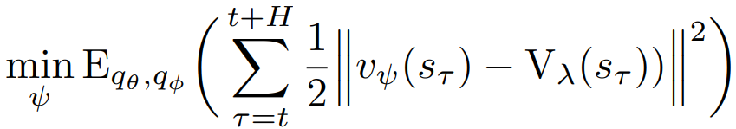
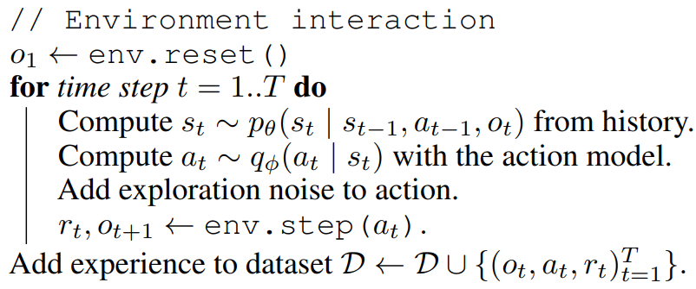
Behavior learning
4
Pseudo code

Slide 27
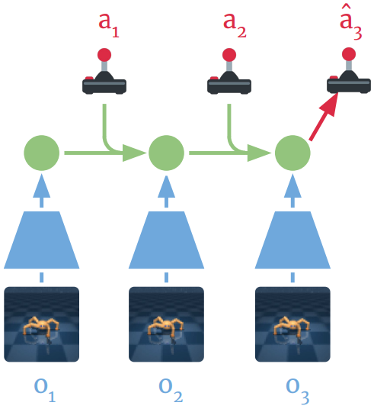
Environment interaction
4
Pseudo code

Slide 28
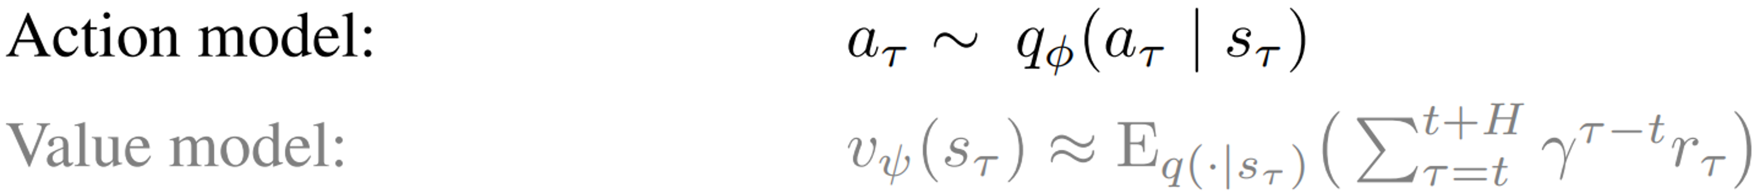
Environment interaction
4
Pseudo code

Slide 29
Environment interaction
4
Pseudo code

Slide 30
Environment interaction
4
Pseudo code

Slide 31
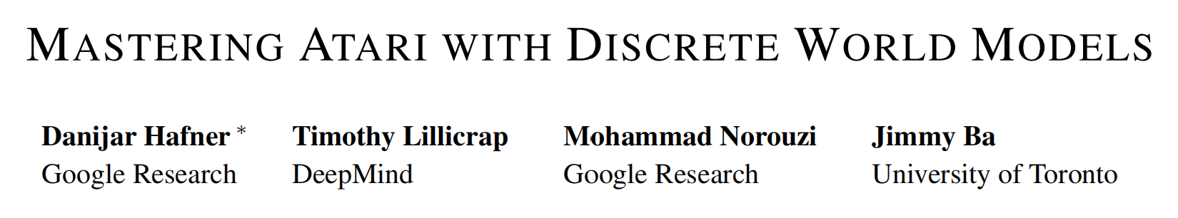
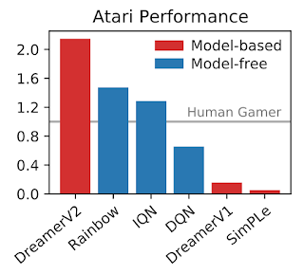
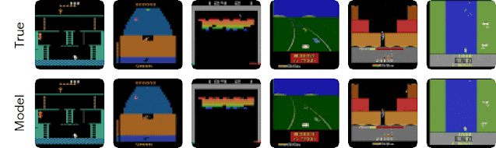
Dreamer V2
5
Mastering Atari with Discrete World Models
ICLR,2021
Notes:
1. 第一个world model > human level
比model-free的rainbow还要好
2. 预测的world model
5 frames as input (not shown) ，45 steps forward given only actions

Slide 32
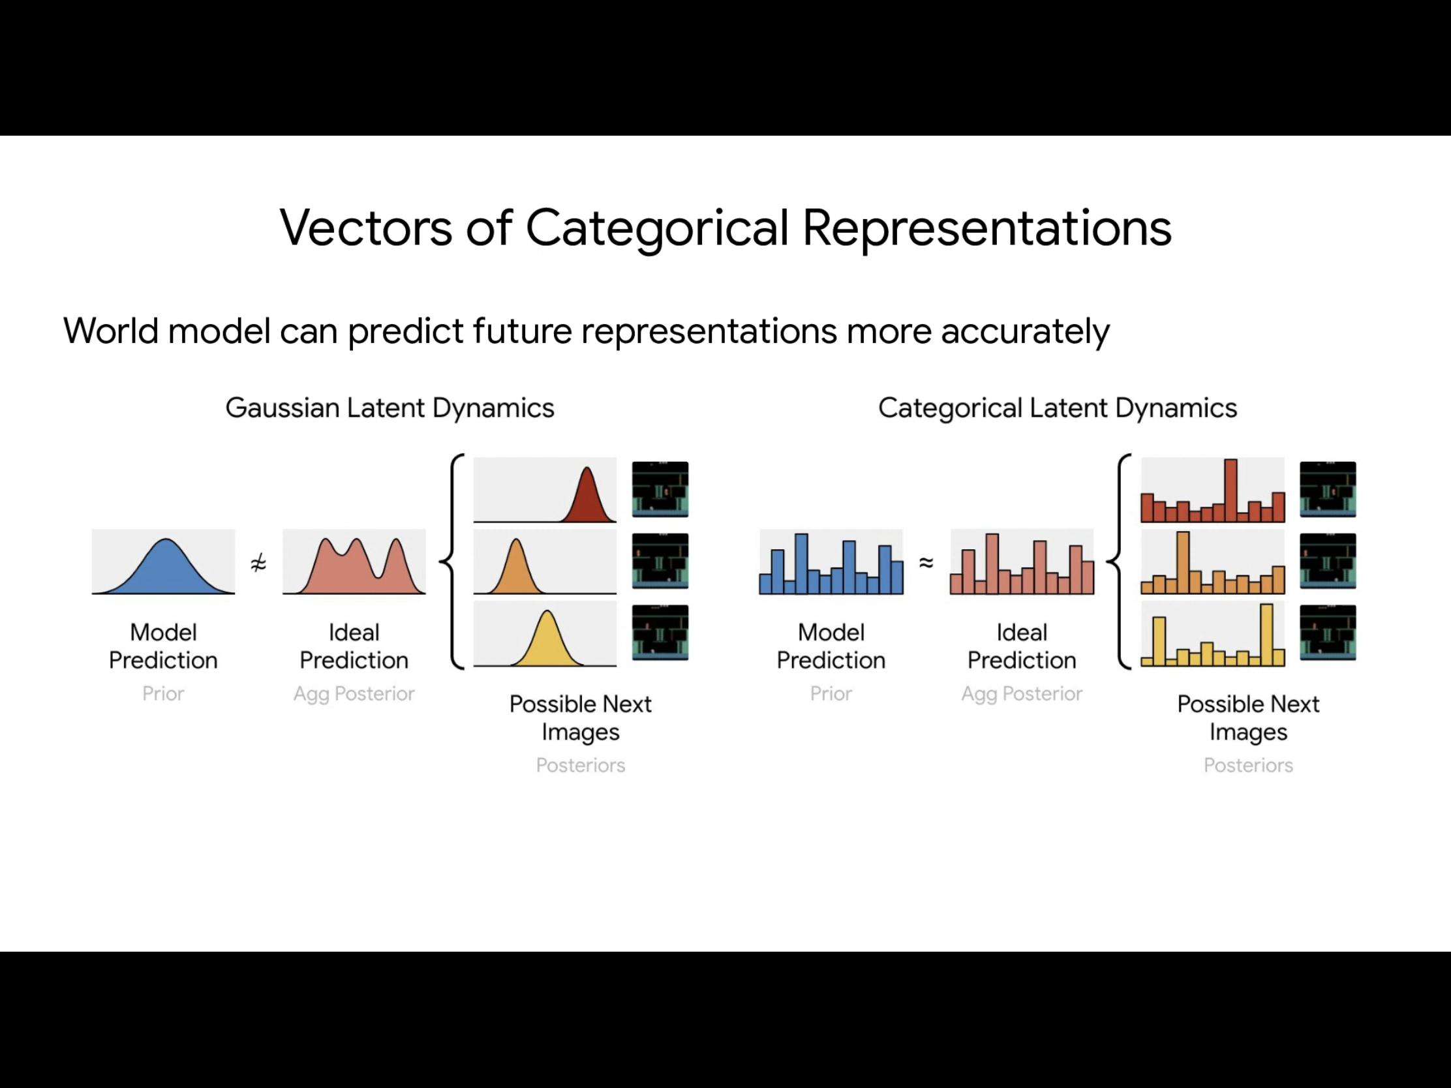
Vectors of Categorical Representations
5
World model can predict future representations more accurately.
Notes:
为什么gradient

Slide 33
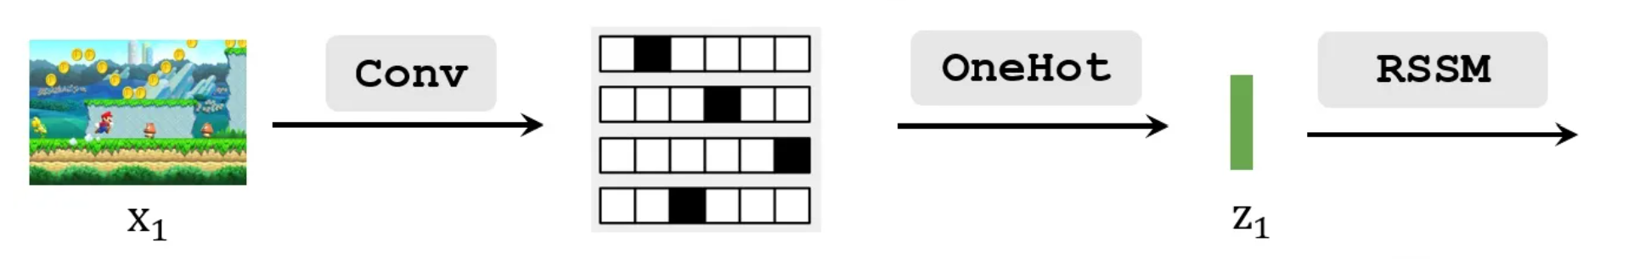
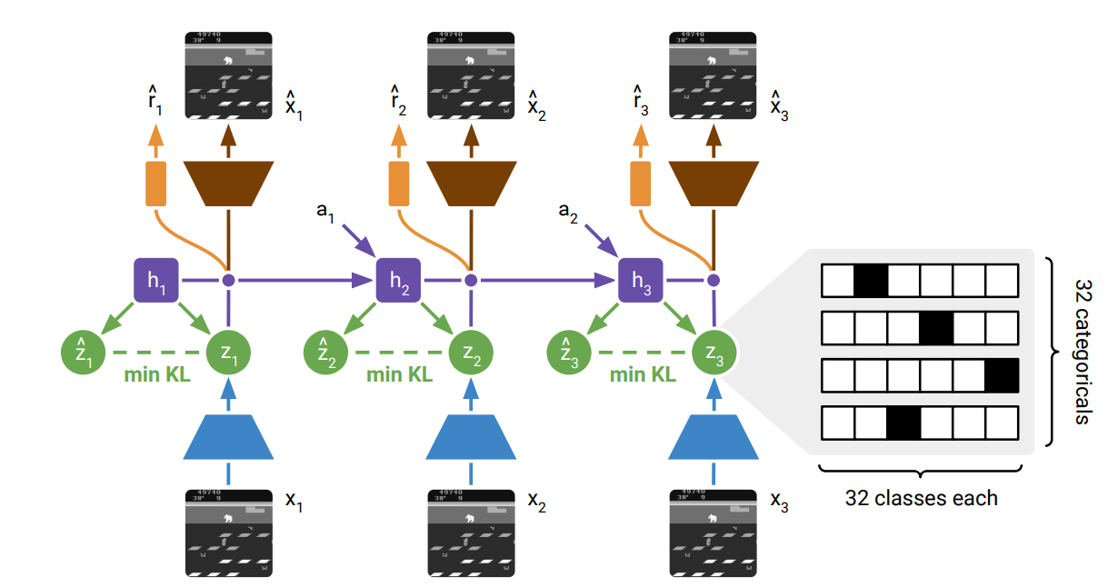
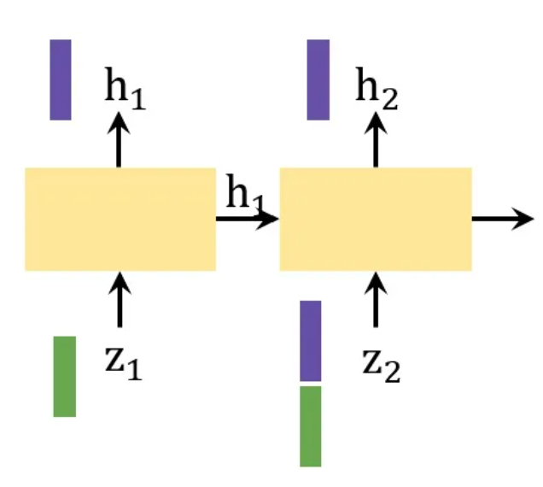
World Model Learning
5

Slide 34
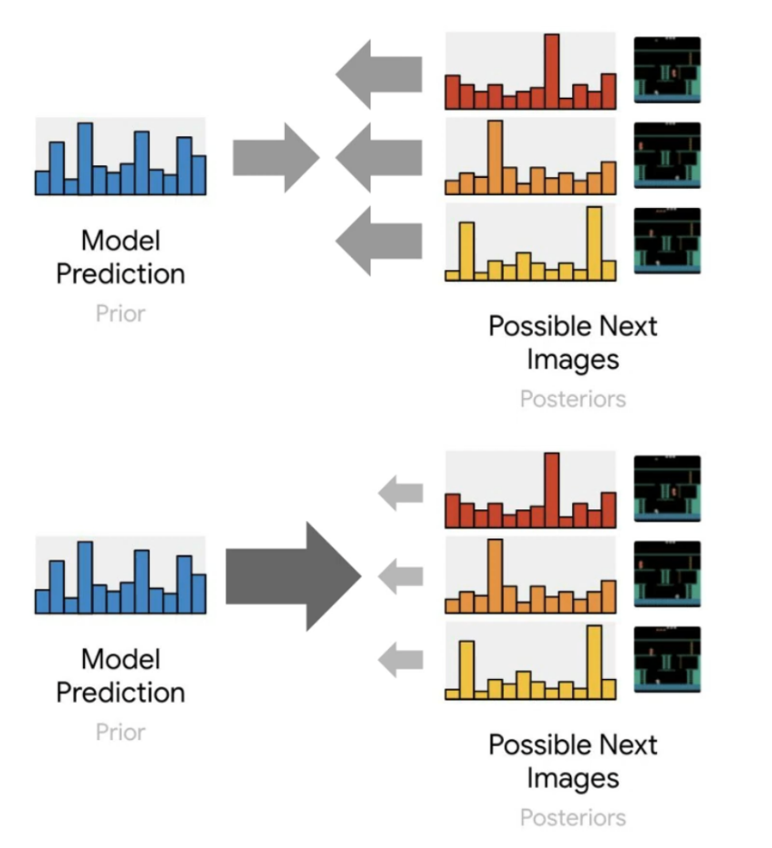
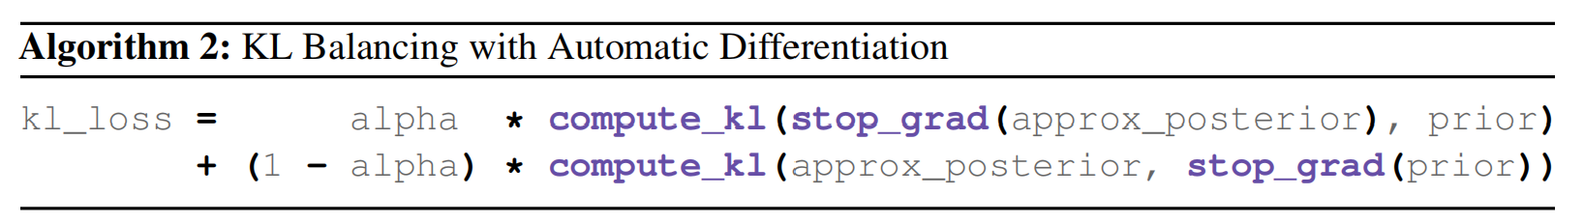
KL Balancing
5
KL regularizer has two purposes:
Regularize representations to stay close to their predictor
Train the predictor to better guess the representations
But learning the predictor is hard
Should not regularize representations toward a poor predictor
Larger learning rate for predictor than for representations
Notes:
Alpha=0.8

Slide 35
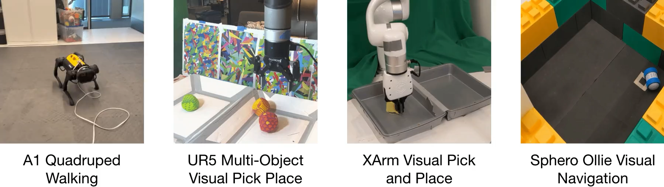
Experiment
6
DayDreamer: World Models for Physical Robot Learning
1) Without Simulators
2) A diverse range of challenges:
Continuous/Discrete
Dense/Spare rewards
Camera inputs/Sensor fusion of multiple input modalities
3) Use the same hyperparameters across all experiments
https://arxiv.org/pdf/2206.14176.pdf

Slide 36
参考论文
7
（1） DREAM TO CONTROL: LEARNING BEHAVIORS BY LATENT IMAGINATION
https://arxiv.org/pdf/1912.01603.pdf
（2） DayDreamer: World Models for Physical Robot Learning
https://export.arxiv.org/pdf/2206.14176.pdf
（3） MASTERING ATARI WITH DISCRETE WORLD MODELS
https://export.arxiv.org/pdf/2010.02193.pdf

